Slide 1
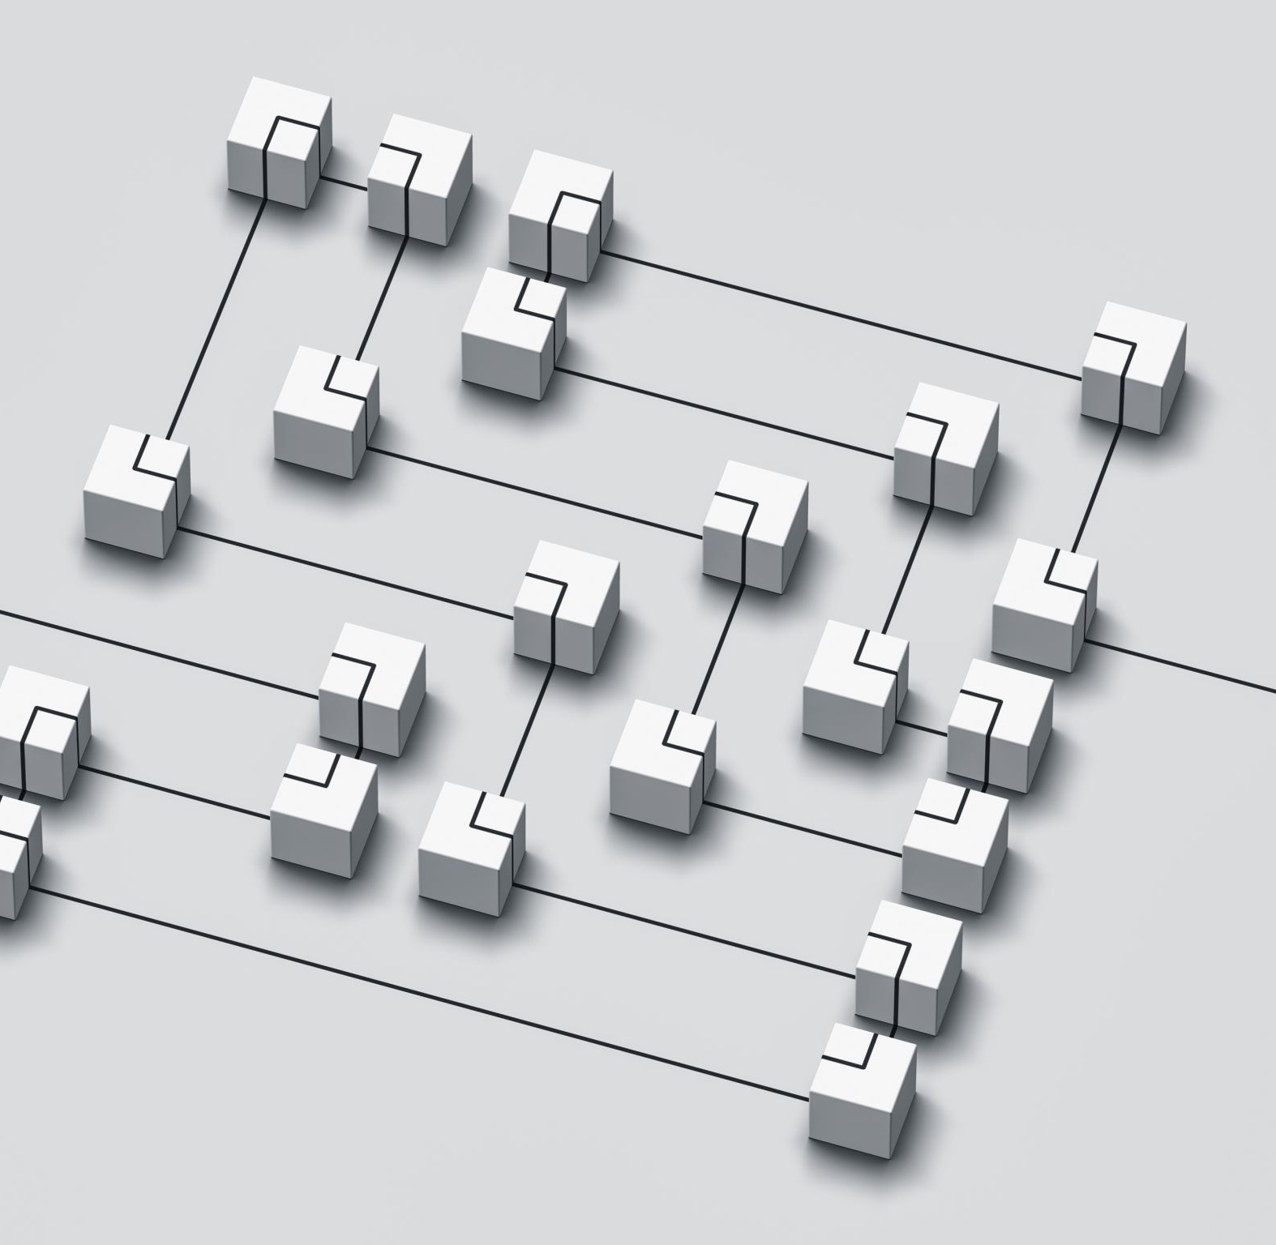

THE INFRASTRUCTURE AS CODE
Deployment Toolchain
@sinisasokolic
E2EVC RENAISSANCE – BERLIN 2022

Slide 2
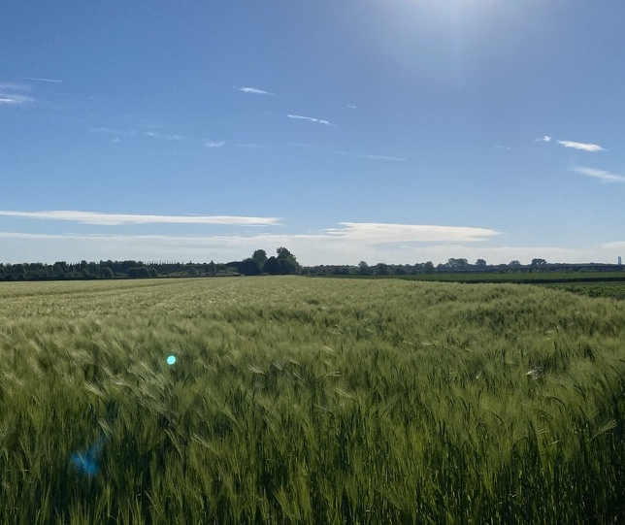
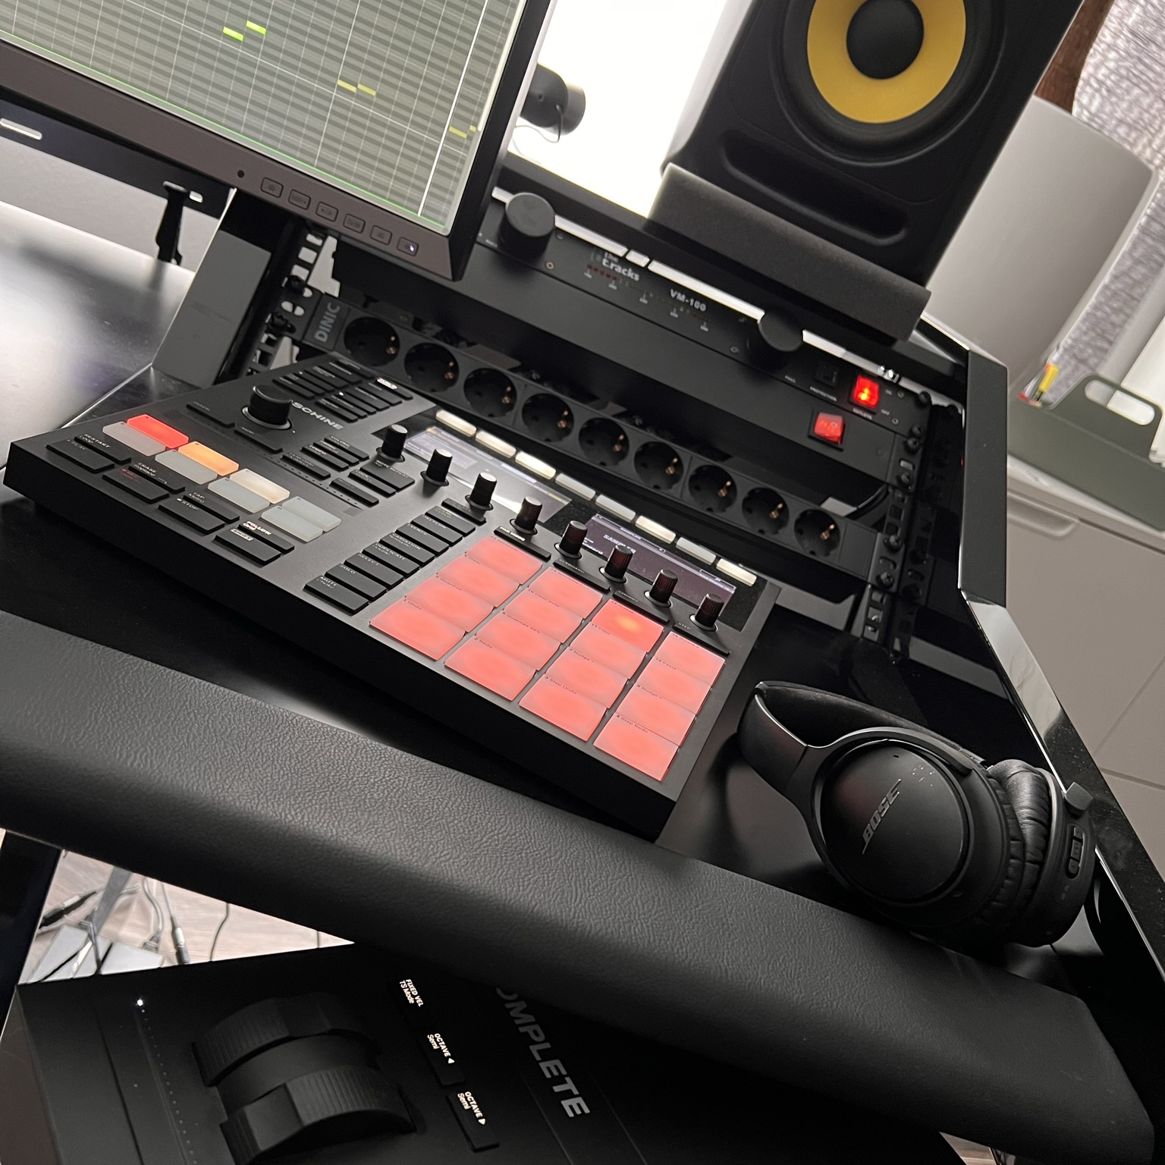

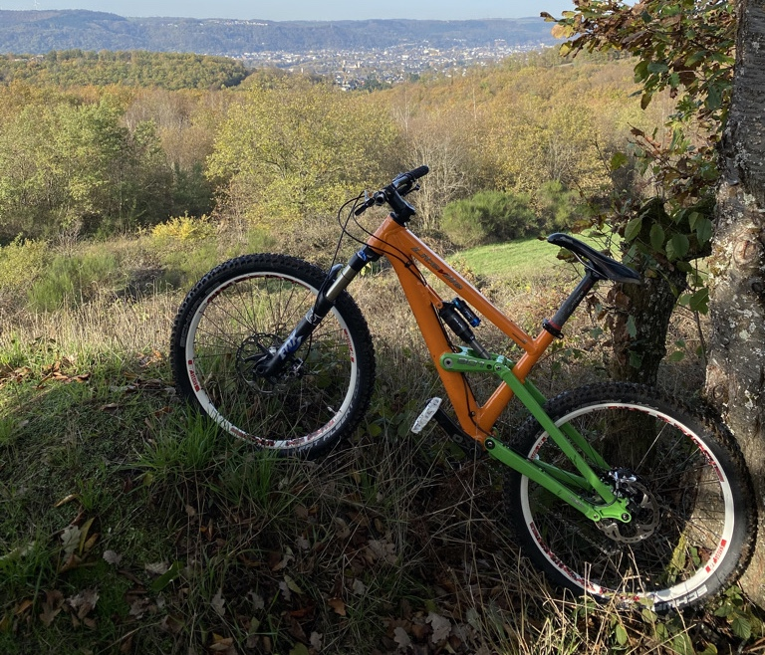


WHO AM I…
My name is Sinisa
CTO@RIS AG
Product Owner@XOAP
Born as Infrastructure Guy
Trying to become a serious dev

Slide 3
Headshot
Easypeezy
E2EVC RENAISSANCE – BERLIN 2022

Slide 4

THE IAC JOURNEY OR: HOW WE LEARNED THAT WE WERE STUPID
E2EVC RENAISSANCE – BERLIN 2022

Slide 5
TERRAFORM IMPLEMENTATION – v1.0.0
STACK - RDS
MAIN.TF
VARIABLES.TF
OUTPUTS.TF
E2EVC RENAISSANCE – BERLIN 2022

Slide 6
TERRAFORM IMPLEMENTATION – v2.0.0
VPC MODULE
MAIN.TF
VARIABLES.TF
STACK – RDS
OUTPUTS.TF
RDS MODULE
MAIN.TF
MAIN.TF
VARIABLES.TF
VARIABLES.TF
OUTPUTS.TF
OUTPUTS.TF
E2EVC RENAISSANCE – BERLIN 2022
Notes:
A stack is a module
A stack orchestrates other modules

Slide 7

TERRAFORM IMPLEMENTATION – v2.0.0
VPC MODULE
MAIN.TF
STACK -KUBERNETES
VARIABLES.TF
STACK - RDS
OUTPUTS.TF
RDS MODULE
main.tfMAIN.TF
MAIN.TF
variables.tf
VARIABLES.TF
OUTPUTSTF
OUTPUTS.TF
E2EVC RENAISSANCE – BERLIN 2022
Notes:
A stack is a module
A stack orchestrates other modules

Slide 8
TERRAFORM IMPLEMENTATION – v3.0.0
VPC MODULE 1.2.0
VPC MODULE
STACK -KUBERNETES
MAIN.TF
STACK - RDS
VARIABLES.TF
RDS MODULE 0.2.0
MAIN.TF
OUTPUTS.TF
RDS MODULE
VARIABLES.TF
MAIN.TF
OUTPUTS.TF
VARIABLES.TF
OUTPUTS.TF
source = "git::github.com/xoap-io/terraform-aws-networking-vpc?ref=v0.1.2"
E2EVC RENAISSANCE – BERLIN 2022
Notes:
A stack is a module
A stack orchestrates other modules

Slide 9
TERRAFORM IMPLEMENTATION – v.4.0.0
MODULE API
IAM MODULE
RANCHER2 MODULE
VPC MODULE
ECR MODULE
MODULE RDS
STACK – LANDING ZONE
STACK - KUBERNETES
STACK - DB
DEPLOYMENT.HCL
DEPLOYMENT.HCL
DEPLOYMENT.HCL
TERRAGRUNT.HCL
TERRAGRUNT.HCL
TERRAGRUNT.HCL
CONFIG.JSON
CONFIG.JSON
CONFIG.JSON
STACK DEPENDENCIES
E2EVC RENAISSANCE – BERLIN 2022
Notes:
Stack dependencies

Slide 10

THE IAC JOURNEY PAIN, HEADACHES, HUMAN ERRORS AND MORE…
E2EVC RENAISSANCE – BERLIN 2022

Slide 11
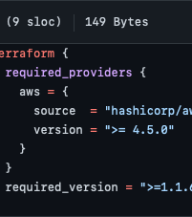
99 PROBLEMS BUT VERSIONING AIN´T ONE
Don´t use the “latest” tag never, ever
Everything should have a version assigned or declared
Pipelines
Modules
Stacks
Extensions
Even: version = ">= 4.5.0” can get you into trouble
But it will also bring you in trouble when you hard-code versions
Put your state files on versioned file shares and make backups
E2EVC RENAISSANCE – BERLIN 2022

Slide 12

99 PROBLEMS BUT THE PIPELINE AIN´T ONE
Pipelines are code either
Pipelines will crash
Because of timeouts
Network interrupts
Cloud Provider issues
Sudden death
Pipelines should run automatically, there is nothing like the pipeline guy, everybody is in the same boat
Learn how to taint resources!
Terraform taint
Learn how to adjust state files!
Terraform state
E2EVC RENAISSANCE – BERLIN 2022

Slide 13

99 PROBLEMS BUT THE DEVELOPER AIN´T ONE
WORKS ON MY MACHINE!
Local versions vs. pipelines versions
e.g. running terraform 1.1.1 locally and latest in pipeline
Prevent approving PRs by the one who requested it
Prevent pushes to master
Different coding styles
Making manual changes in production accounts
Will kill your state files and pipelines
Lack of architecture
Spaghetti code
Lack of documentation
E2EVC RENAISSANCE – BERLIN 2022

Slide 14

99 PROBLEMS BUT THE CLOUD PROVIDER AIN´T ONE
Check change logs frequently to be notified of provider changes
This will kill your pipeline and in worst case state files
Services issues although status is green
Service changes without proper notification
Run pipelines every day
This won´t safe you from harm, but will reduce impacts
Yes, we all are beta testers
We killed Opensearch multiple times and had to wait for AWS to fix it
If Github or Azure repos are unavailable you won´t deploy anything
Replicate code and use hosted runners
E2EVC RENAISSANCE – BERLIN 2022

Slide 15
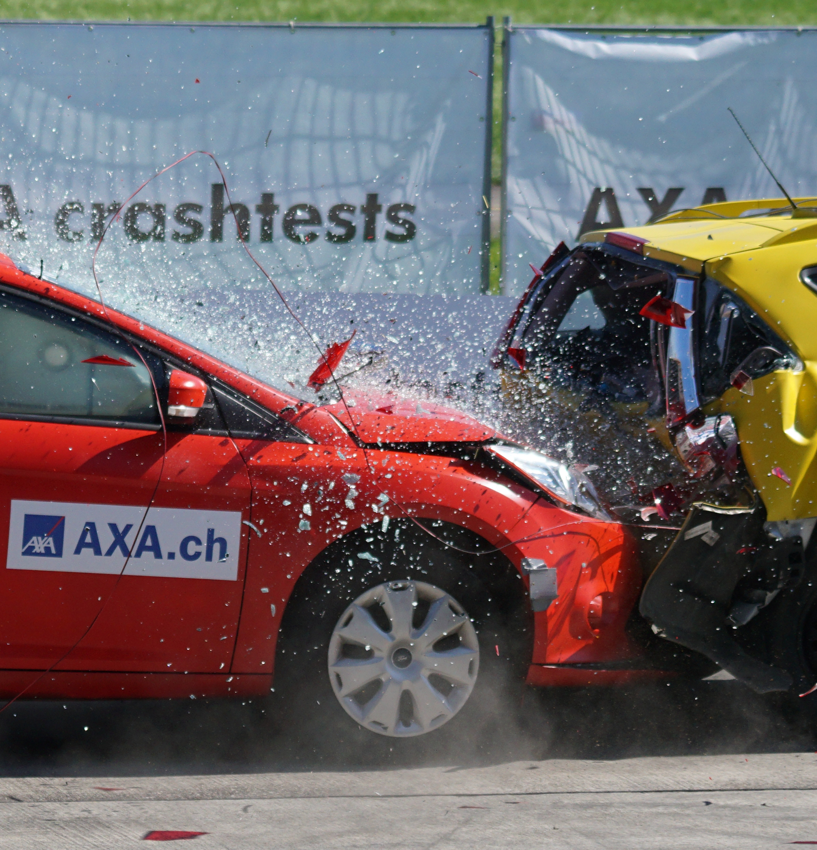
99 PROBLEMS BUT TESTING AIN`T ONE
Run pipelines frequently… daily
Don´t deploy central services without a dev environment (dev Landing zone)
Destroy, deploy, destroy, deploy…
Test multiple times
Developers are the worst testers
Developers will find a way that test will always succeed
PRs with multiple approvers
Even 4 eye principle sucks!
E2EVC RENAISSANCE – BERLIN 2022

Slide 16

99 PROBLEMS BUT SECURITY AIN´T ONE
Don´t use wildcards in policies
Don´t use weak passwords, even if you just test something
Thank you for letting me test.
Least privileges, especially for your developers
Don´t use access keys, use assume role or Vault for secrets
Use everything that can improve security
No users in root account, use central security account
E2EVC RENAISSANCE – BERLIN 2022

Slide 17
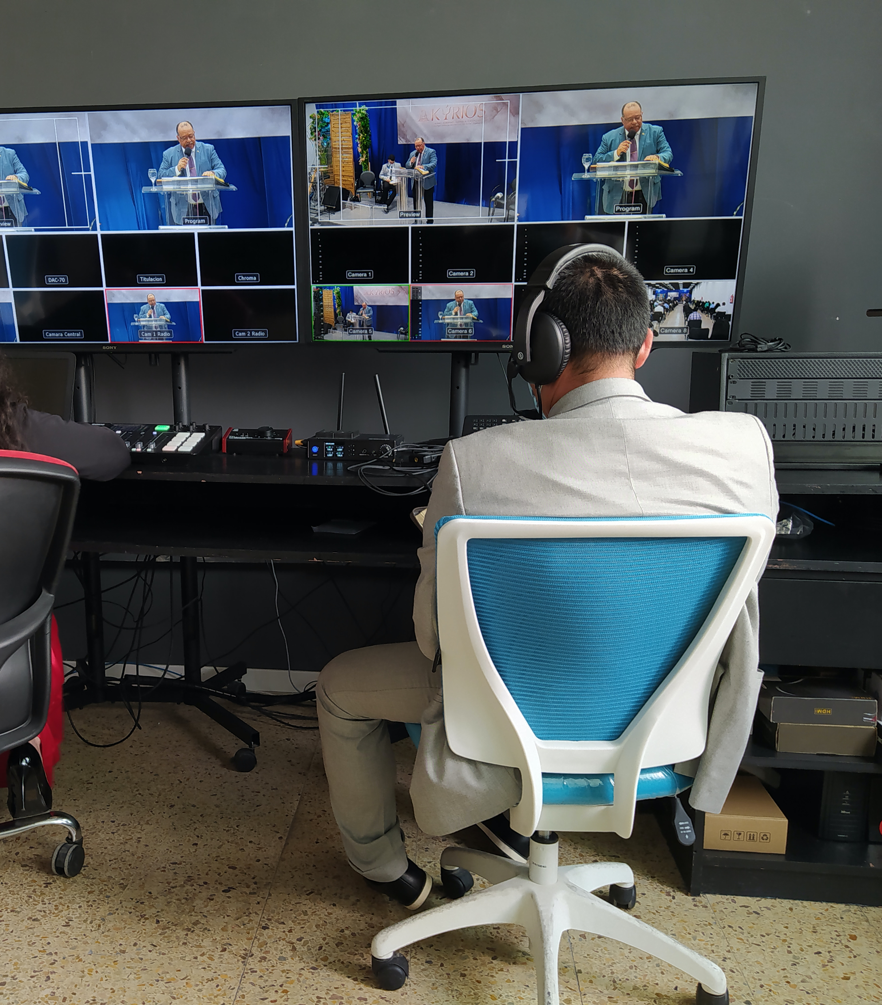
99 PROBLEMS BUT OPERATIONS AIN´T ONE
Never Change a Running System
Is the most dumb thing you can do!
Don´t run Terraform on Windows:
Because not all providers work on it
Because a lot of available shell scripts don´t run on it
Because case sensitivity on cloud hosted pipelines kills your pipeline
Having smooth pipelines is now one of your main responsibilities
Testing too…
E2EVC RENAISSANCE – BERLIN 2022

Slide 18
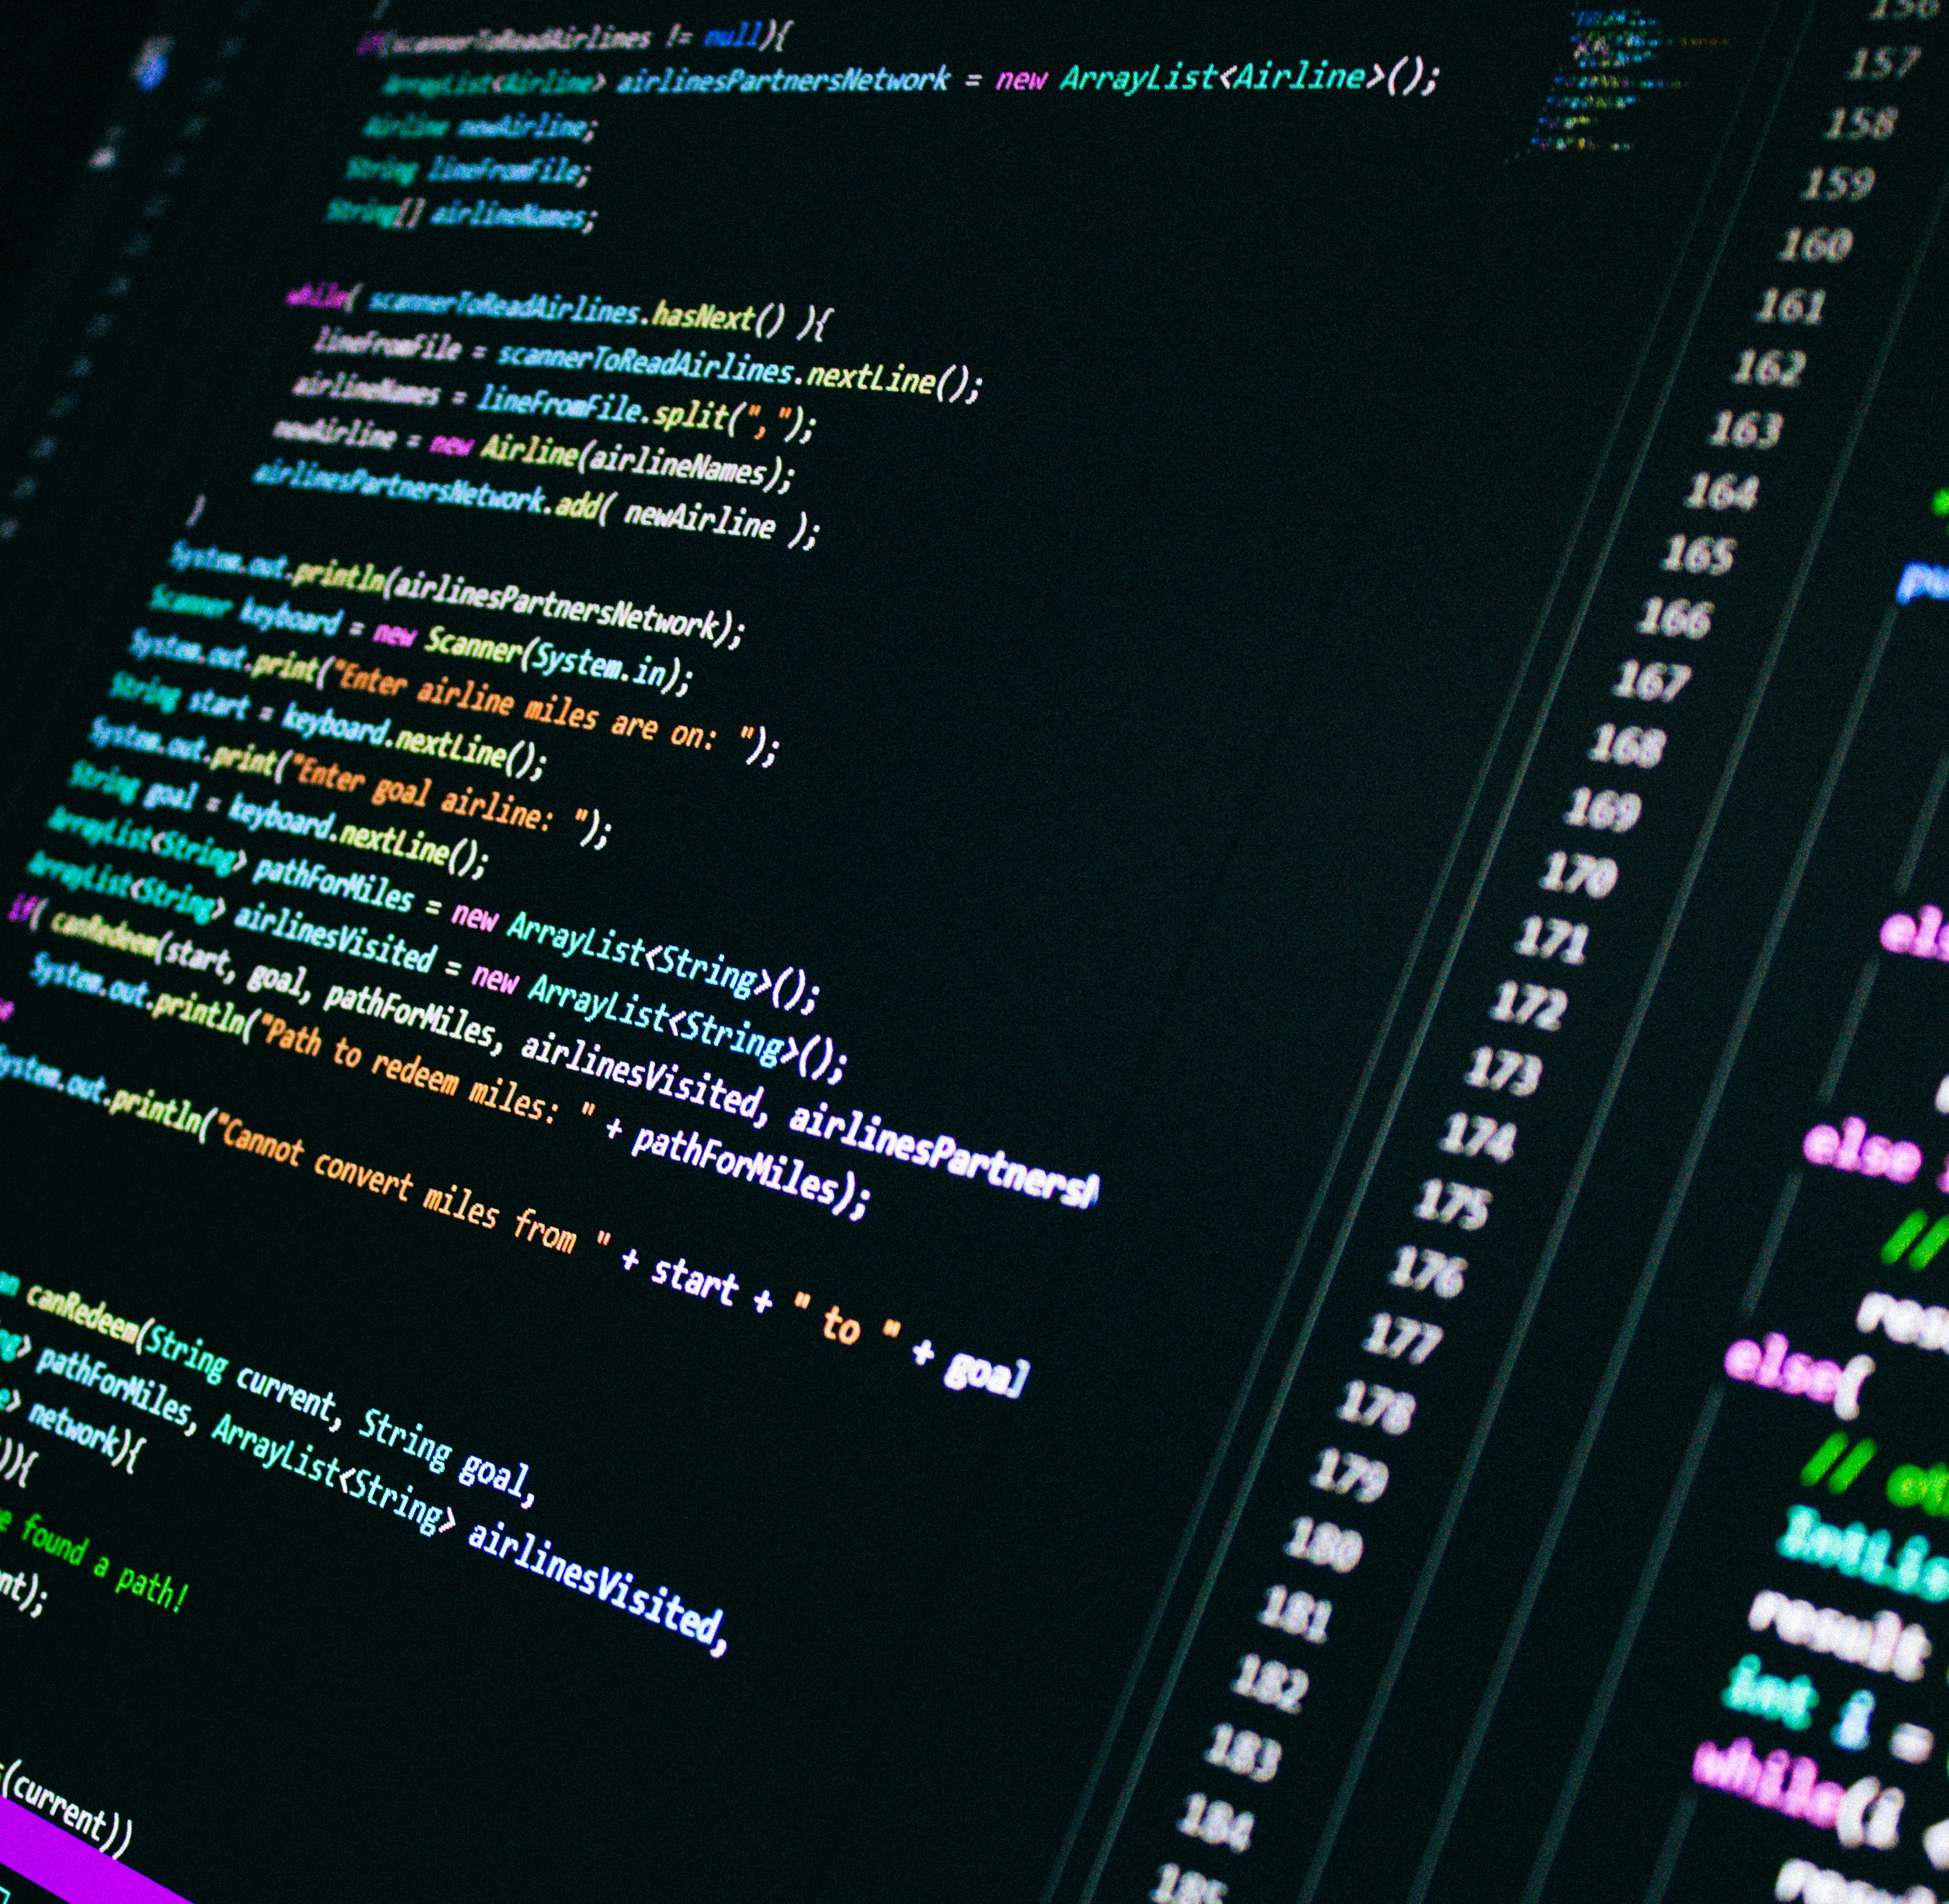
99 PROBLEMS BUT TERRAFORM AIN´T ONE
Keep your code dry
Get rid of duplicated backend code
Keep your Stacks small
Define max. 200 resources
Don´t run tf locally
Implement State file versioning (locking)
Don´t change stuff manually
If you really need import to State file afterwards
Plan architecture wisely (Chicken/Egg problem)
Don´t use Windows
E2EVC RENAISSANCE – BERLIN 2022

Slide 19
TERRAFORM IMPLEMENTATION – v.0.5.0 - insert to every full version wherever you want
Linting
Commit Conventions
Build Artefacts
Templates
Tagging
Branch Protection
BOM
EOL
Syntax Checks
Prettier
Repo policies
User Stories
URL Checks
tfdocs
Dependabot
Testing
Checkov
tfsec
Kics
Change logs
Infracost
Credential Checking
Landing Zones
Dependency hell
E2EVC RENAISSANCE – BERLIN 2022
Notes:
Duplicate code
Differences in stages

Slide 20
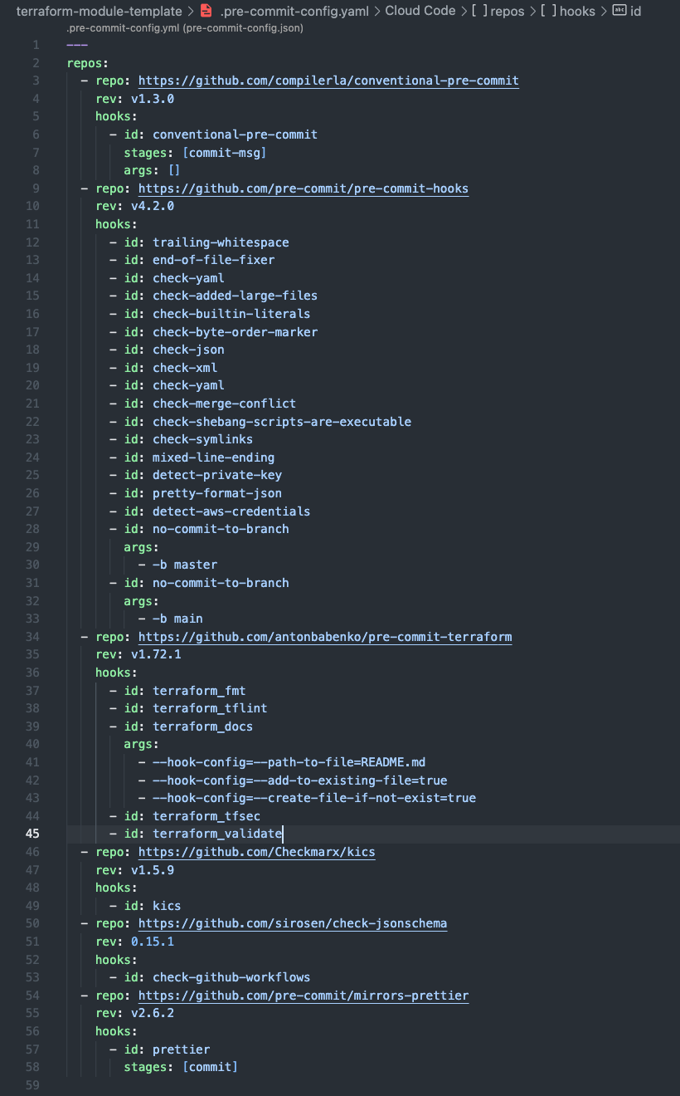
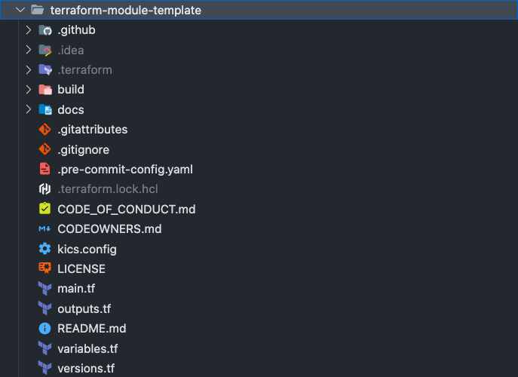
E2EVC RENAISSANCE – BERLIN 2022

Slide 21

WORKFLOW
linting
security
syntax
prettier
naming
conventions
tags
versioning
security
costs
documentation
Dependencies
+
pre-commits
+
tf plan
GitHub
development
branch
GitHub
master
branch
pre-commits
push
pr
actions
Write code
pipeline(s)
E2EVC RENAISSANCE – BERLIN 2022

Slide 22
TERRAFORM JOURNEY
 | Terraform v.1.0.0 | Terraform v.2.0.0 | Terraform v.3.0.0 | Terraform v.4.0.0 | Terraform v.4.5.0
Modules | One Module | Multiple | Multiple | A lot | A lot
Repositories | One Git repo | One Git repo | Multiple Git repos | A lot | A lot
Git Branches | mostly none, tf_vars | Dev,acc,prd, Often none, tf_vars | Dev, acc, prd, Development, PRs | A lot, PRs | A lot, PRs
Collaboration | One individual | One individual | Multiple individuals | Some teams | Multiple Teams
Versioning | No versioning, local state file | No versioning, local state, state in git | Versioning, central multiple state files (maybe locking) | Versioning, multiple state files, locking | Versioning, multiple state files, locking
Infrastructure complexity | One tenant or subscription | One tenant or subscription | Multiple accounts | Landing Zone | Multi Cloud
Planning | none | None, maybe Kanban | Kanban or SCRUM | SCRUM | SCRUM of SCRUMS
Orchestration | Terraform | Terraform | Terraform | Terragrunt | Terragrunt
E2EVC RENAISSANCE – BERLIN 2022

Slide 23


VISIT THE MASTERCLASS AT 14:00
@SINISASOKOLIC
S.SOKOLIC@RIS.AG
E2EVC RENAISSANCE – BERLIN 2022

